Slide 1
Chapter 5: CPU Scheduling

Slide 2
Outline
Basic Concepts
Scheduling Criteria
Scheduling Algorithms
Thread Scheduling
Multi-Processor Scheduling
Real-Time CPU Scheduling
Operating Systems Examples
Algorithm Evaluation

Slide 3
Objectives
Describe various CPU scheduling algorithms
Assess CPU scheduling algorithms based on scheduling criteria
Explain the issues related to multiprocessor and multicore scheduling
Describe various real-time scheduling algorithms
Describe the scheduling algorithms used in the Windows, Linux, and Solaris operating systems
Apply modeling and simulations to evaluate CPU scheduling algorithms

Slide 4
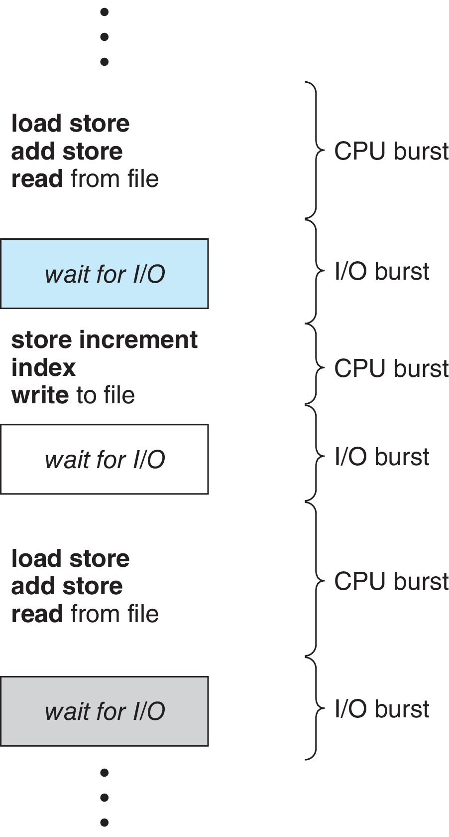
Basic Concepts
Maximum CPU utilization obtained with multiprogramming
CPU–I/O Burst Cycle – Process execution consists of a cycle of CPU execution and I/O wait
CPU burst followed by I/O burst
CPU burst distribution is of main concern

Slide 5
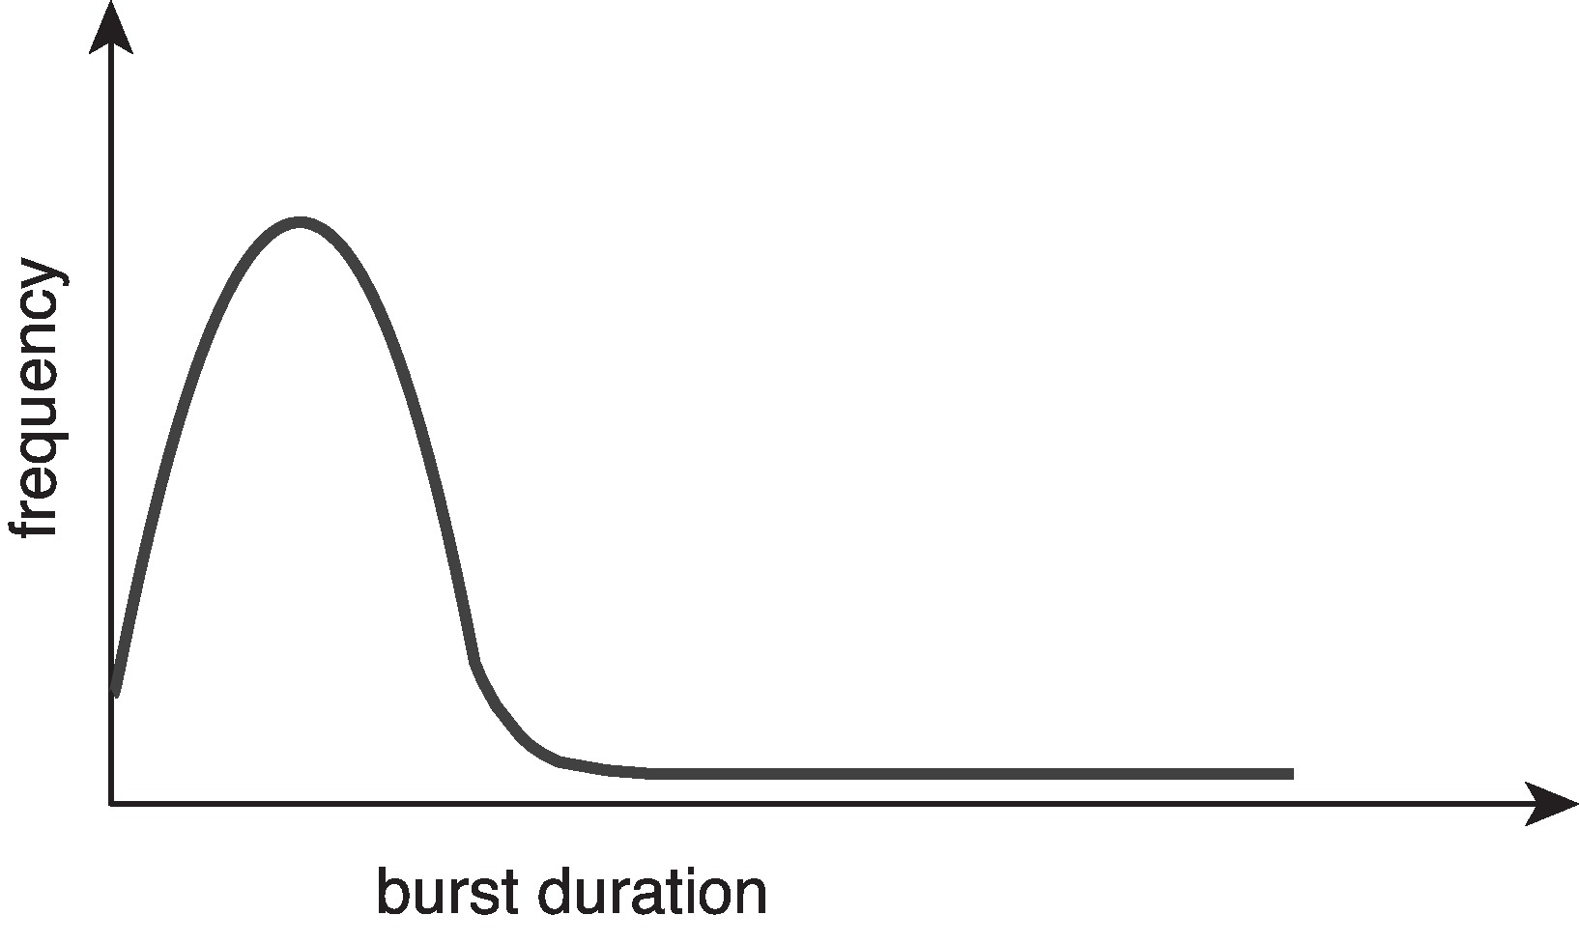
Histogram of CPU-burst Times
Large number of short bursts
Small number of longer bursts

Slide 6
CPU Scheduler
The CPU scheduler selects from among the processes in ready queue, and allocates a CPU core to one of them
Queue may be ordered in various ways
CPU scheduling decisions may take place when a process:
1. Switches from running to waiting state
2. Switches from running to ready state
3. Switches from waiting to ready
Terminates
For situations 1 and 4, there is no choice in terms of scheduling. A new process (if one exists in the ready queue) must be selected for execution.
For situations 2 and 3, however, there is a choice.

Slide 7
Preemptive and Nonpreemptive Scheduling
When scheduling takes place only under circumstances 1 and 4, the scheduling scheme is nonpreemptive.
Otherwise, it is preemptive.
Under Nonpreemptive scheduling, once the CPU has been allocated to a process, the process keeps the CPU until it releases it either by terminating or by switching to the waiting state.
Virtually all modern operating systems including Windows, MacOS, Linux, and UNIX use preemptive scheduling algorithms.

Slide 8
Preemptive Scheduling and Race Conditions
Preemptive scheduling can result in race conditions when data are shared among several processes.
Consider the case of two processes that share data. While one process is updating the data, it is preempted so that the second process can run. The second process then tries to read the data, which are in an inconsistent state.
This issue will be explored in detail in Chapter 6.

Slide 9
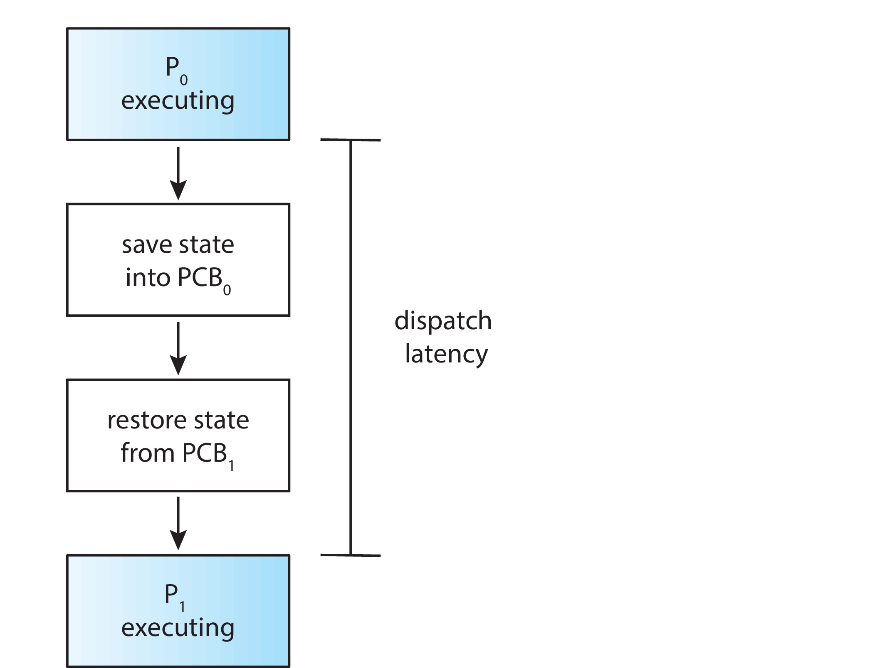
Dispatcher
Dispatcher module gives control of the CPU to the process selected by the CPU scheduler; this involves:
Switching context
Switching to user mode
Jumping to the proper location in the user program to restart that program
Dispatch latency – time it takes for the dispatcher to stop one process and start another running

Slide 10
Scheduling Criteria
CPU utilization – keep the CPU as busy as possible
Throughput – # of processes that complete their execution per time unit
Turnaround time – amount of time to execute a particular process
Waiting time – amount of time a process has been waiting in the ready queue
Response time – amount of time it takes from when a request was submitted until the first response is produced.

Slide 11
Scheduling Algorithm Optimization Criteria
Max CPU utilization
Max throughput
Min turnaround time
Min waiting time
Min response time

Slide 12
First- Come, First-Served (FCFS) Scheduling
Process Burst Time
P₁ 24
P₂ 3
P₃ 3
Suppose that the processes arrive in the order: P₁ , P₂ , P₃ The Gantt Chart for the schedule is:
Waiting time for P₁ = 0; P₂ = 24; P₃ = 27
Average waiting time: (0 + 24 + 27)/3 = 17

Slide 13
FCFS Scheduling (Cont.)
Suppose that the processes arrive in the order:
P₂ , P₃ , P₁
The Gantt chart for the schedule is:
Waiting time for P₁ = 6; P₂ = 0; P₃ = 3
Average waiting time: (6 + 0 + 3)/3 = 3
Much better than previous case
Convoy effect - short process behind long process
Consider one CPU-bound and many I/O-bound processes

Slide 14
Shortest-Job-First (SJF) Scheduling
Associate with each process the length of its next CPU burst
Use these lengths to schedule the process with the shortest time
SJF is optimal – gives minimum average waiting time for a given set of processes
Preemptive version called shortest-remaining-time-first
How do we determine the length of the next CPU burst?
Could ask the user
Estimate

Slide 15
Example of SJF
Process Burst Time
P₁ 6
P₂ 8
P₃ 7
P₄ 3
SJF scheduling chart
Average waiting time = (3 + 16 + 9 + 0) / 4 = 7

Slide 16
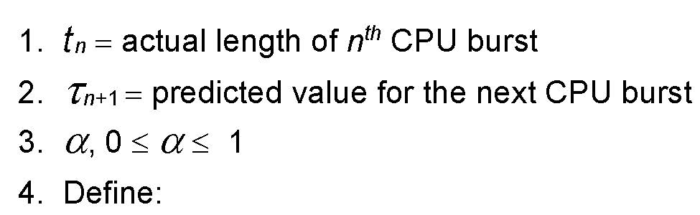

Determining Length of Next CPU Burst
Can only estimate the length – should be similar to the previous one
Then pick process with shortest predicted next CPU burst
Can be done by using the length of previous CPU bursts, using exponential averaging
Commonly, α set to ½

Slide 17
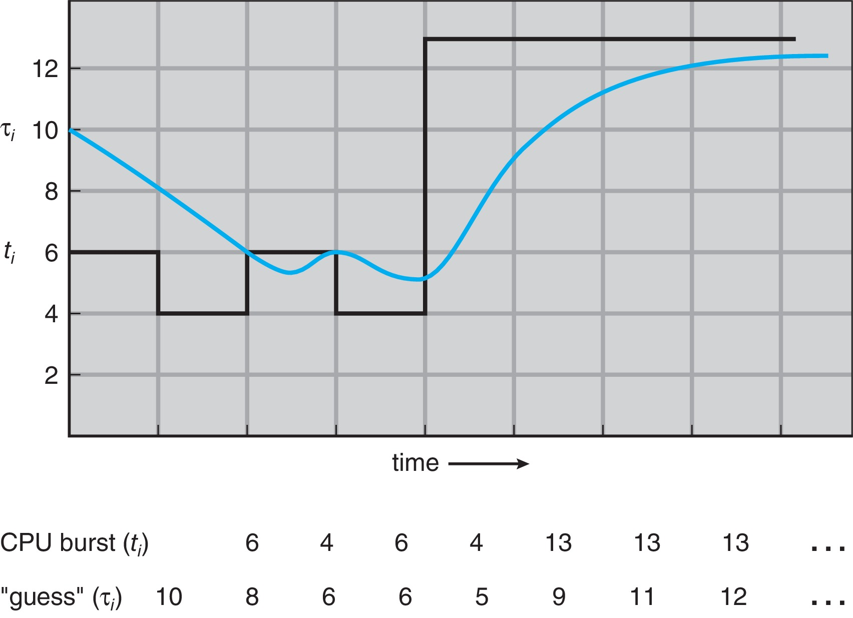
Prediction of the Length of the Next CPU Burst

Slide 18
Examples of Exponential Averaging
α =0
τ_{n+1} = τ_{n}
Recent history does not count
α =1
τ_{n+1} = α t_{n}
Only the actual last CPU burst counts
If we expand the formula, we get:
τ_{n+1} = α t_{n}+(1 - α)α t_{n} ₋₁ + …
+(1 - α )^{j} α t_{n} _{-j} + …
+(1 - α )^{n +1} τ₀
Since both α and (1 - α) are less than or equal to 1, each successor predecessor term has less weight than its predecessor

Slide 19
Shortest Remaining Time First Scheduling
Preemptive version of SJN
Whenever a new process arrives in the ready queue, the decision on which process to schedule next is redone using the SJN algorithm.
Is SRT more “optimal” than SJN in terms of the minimum average waiting time for a given set of processes?

Slide 20
Example of Shortest-remaining-time-first
Now we add the concepts of varying arrival times and preemption to the analysis
Process i Arrival TimeT Burst Time
P₁ 0 8
P₂ 1 4
P₃ 2 9
P₄ 3 5
Preemptive SJF Gantt Chart
Average waiting time = [(10-1)+(1-1)+(17-2)+(5-3)]/4 = 26/4 = 6.5

Slide 21
Round Robin (RR)
Each process gets a small unit of CPU time (time quantum q), usually 10-100 milliseconds. After this time has elapsed, the process is preempted and added to the end of the ready queue.
If there are n processes in the ready queue and the time quantum is q, then each process gets 1/n of the CPU time in chunks of at most q time units at once. No process waits more than (n-1)q time units.
Timer interrupts every quantum to schedule next process
Performance
q large ⇒ FIFO (FCFS)
q small ⇒ RR
Note that q must be large with respect to context switch, otherwise overhead is too high

Slide 22
Example of RR with Time Quantum = 4
Process Burst Time
P₁ 24
P₂ 3
P₃ 3
The Gantt chart is:
Typically, higher average turnaround than SJF, but better response
q should be large compared to context switch time
q usually 10 milliseconds to 100 milliseconds,
Context switch < 10 microseconds

Slide 23
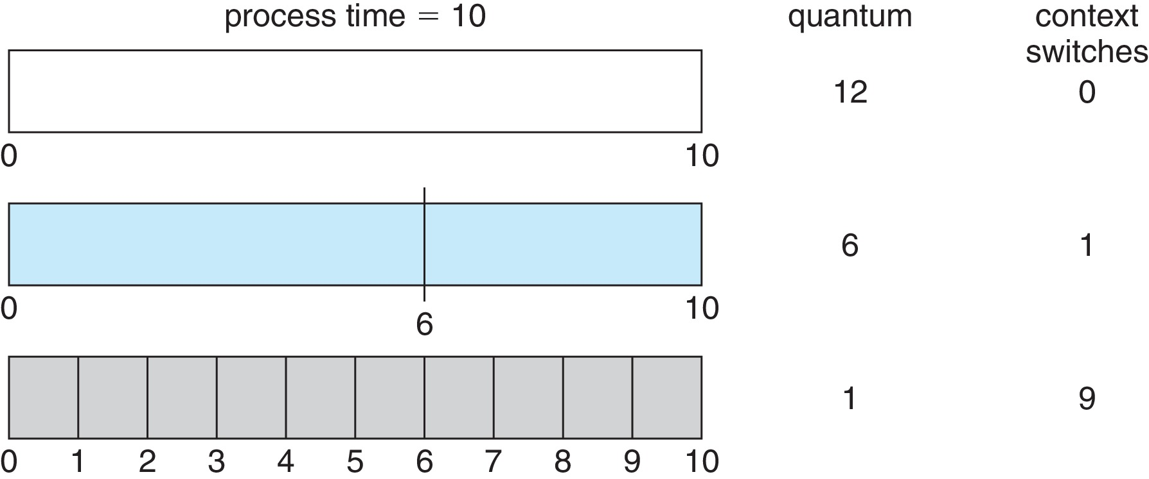
Time Quantum and Context Switch Time

Slide 24
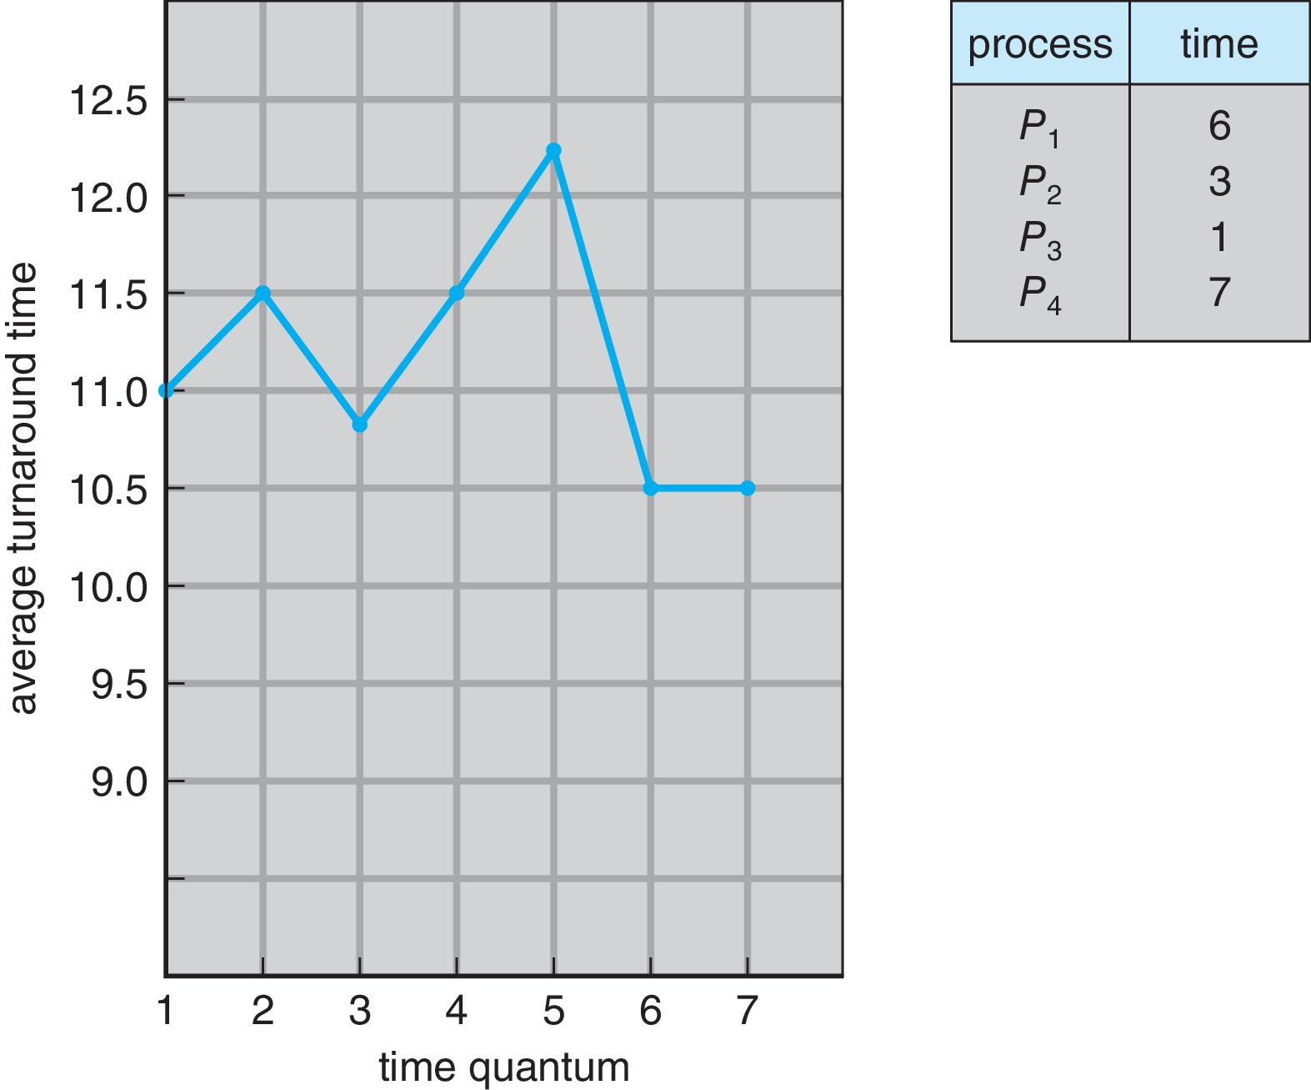
Turnaround Time Varies With The Time Quantum
80% of CPU bursts should be shorter than q

Slide 25
Priority Scheduling
A priority number (integer) is associated with each process
The CPU is allocated to the process with the highest priority (smallest integer ≡ highest priority)
Preemptive
Nonpreemptive
SJF is priority scheduling where priority is the inverse of predicted next CPU burst time
Problem ≡ Starvation – low priority processes may never execute
Solution ≡ Aging – as time progresses increase the priority of the process

Slide 26
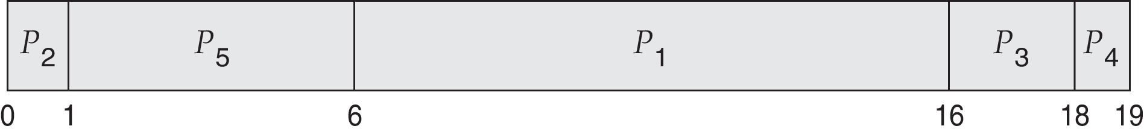
Example of Priority Scheduling
Process Burst Time Priority
P₁ 10 3
P₂ 1 1
P₃ 2 4
P₄ 1 5
P₅ 5 2
Priority scheduling Gantt Chart
Average waiting time = 8.2

Slide 27
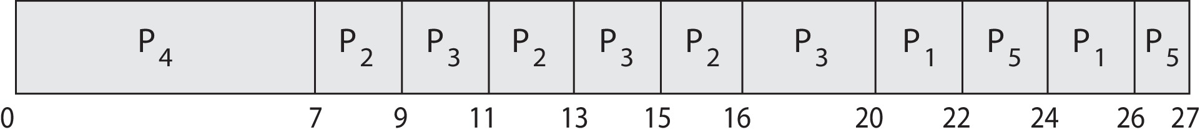
Priority Scheduling w/ Round-Robin
Run the process with the highest priority. Processes with the same priority run round-robin
Example:
Process a Burst Time Priority
P₁ 4 3
P₂ 5 2
P₃ 8 2
P₄ 7 1
P₅ 3 3
Gantt Chart with time quantum = 2

Slide 28
Multilevel Queue
The ready queue consists of multiple queues
Multilevel queue scheduler defined by the following parameters:
Number of queues
Scheduling algorithms for each queue
Method used to determine which queue a process will enter when that process needs service
Scheduling among the queues

Slide 29
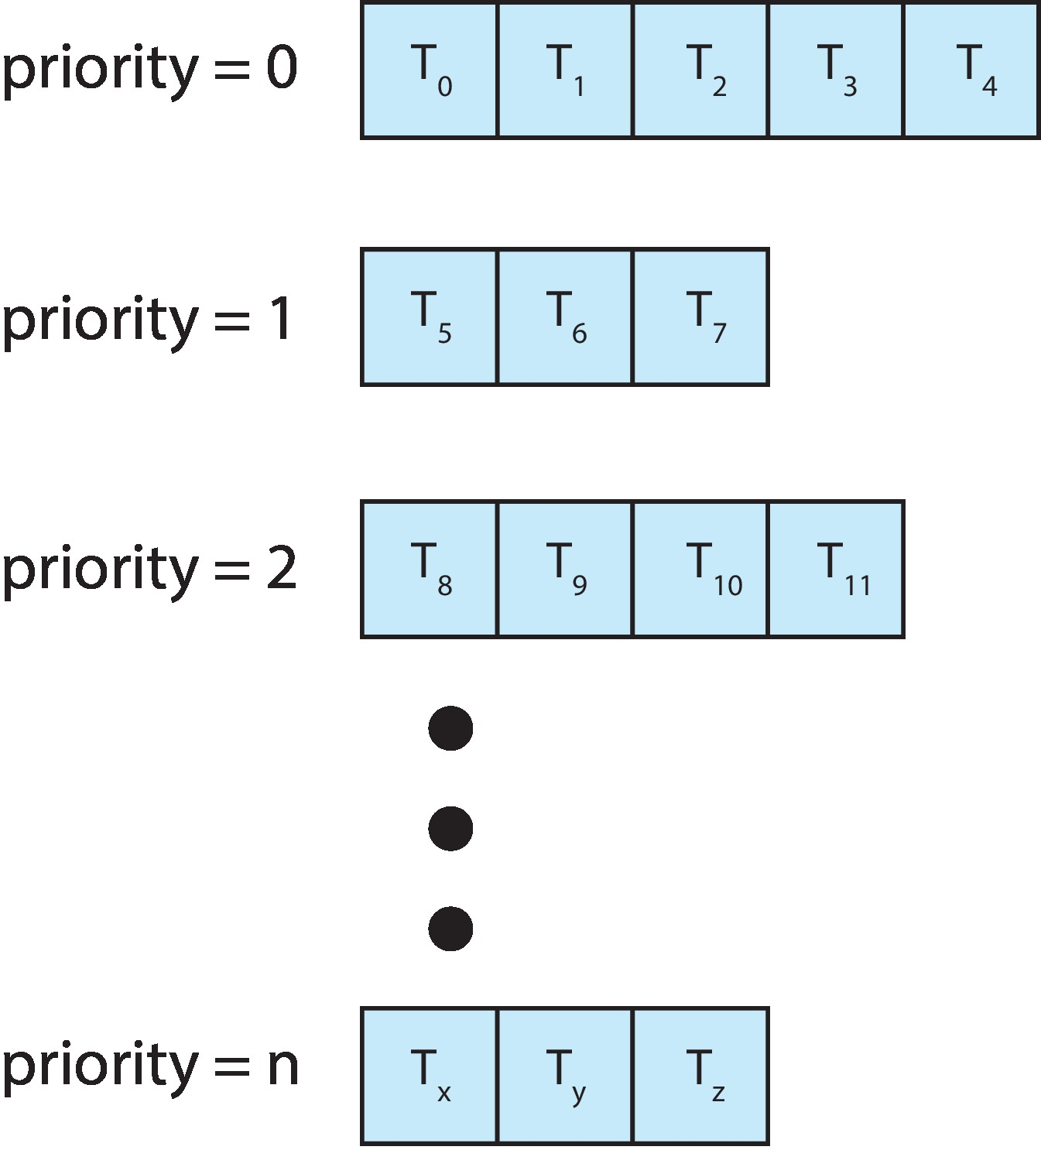
Multilevel Queue
With priority scheduling, have separate queues for each priority.
Schedule the process in the highest-priority queue!

Slide 30
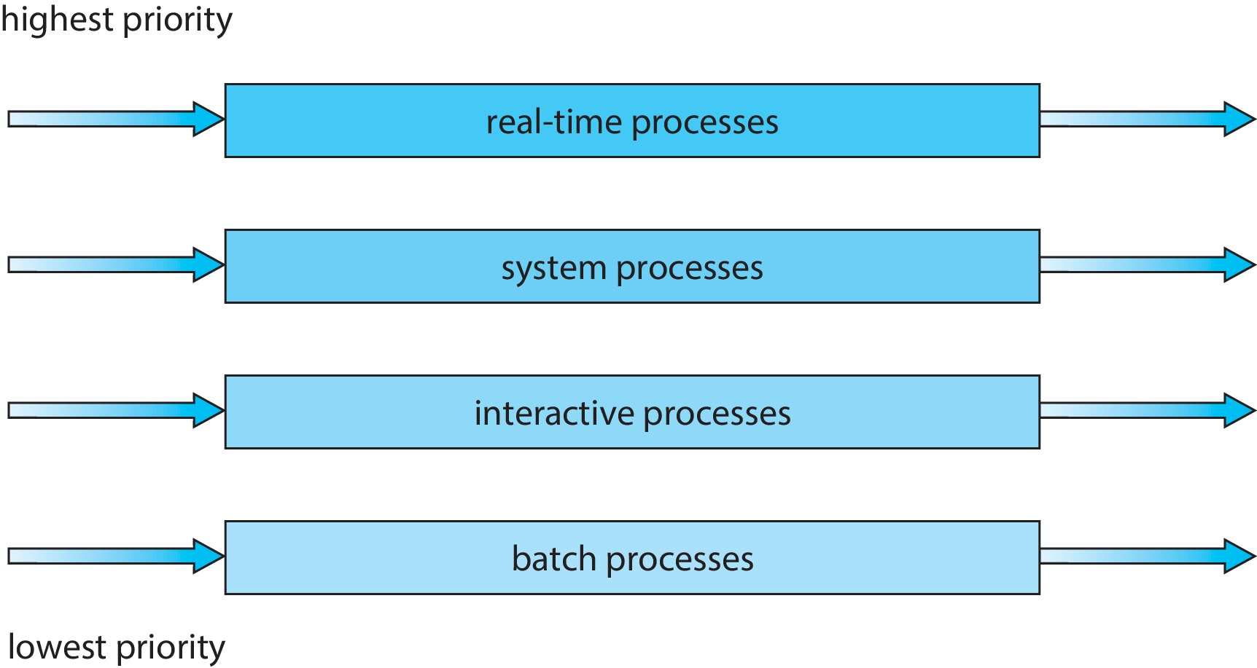
Multilevel Queue
Prioritization based upon process type

Slide 31
Multilevel Feedback Queue
A process can move between the various queues.
Multilevel-feedback-queue scheduler defined by the following parameters:
Number of queues
Scheduling algorithms for each queue
Method used to determine when to upgrade a process
Method used to determine when to demote a process
Method used to determine which queue a process will enter when that process needs service
Aging can be implemented using multilevel feedback queue

Slide 32
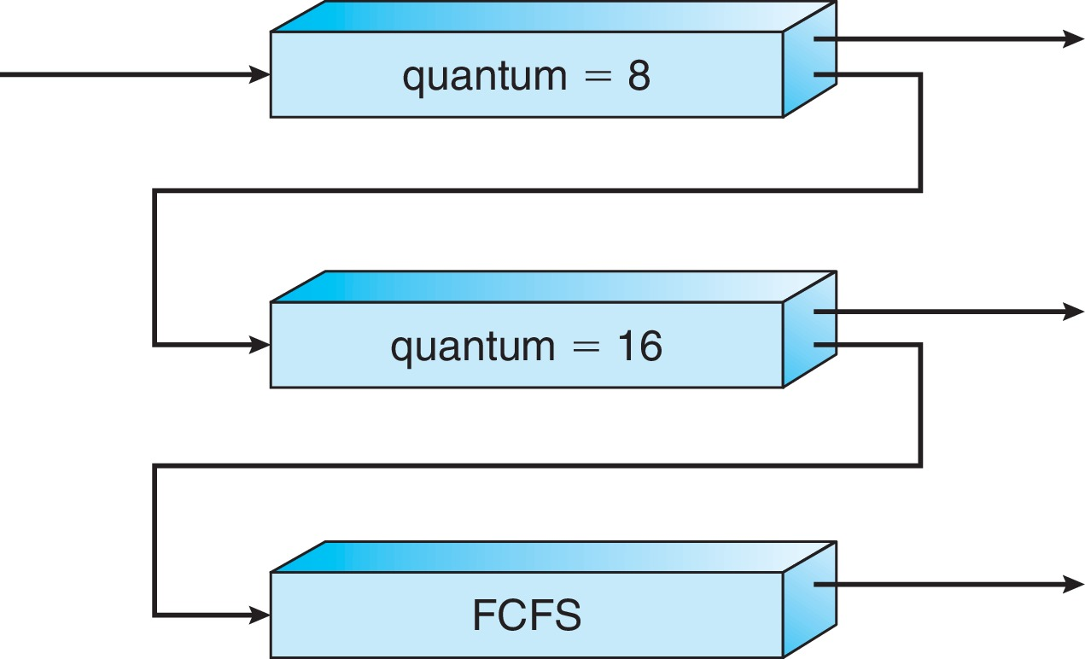
Example of Multilevel Feedback Queue
Three queues:
Q₀ – RR with time quantum 8 milliseconds
Q₁ – RR time quantum 16 milliseconds
Q₂ – FCFS
Scheduling
A new process enters queue Q₀ which is served in RR
When it gains CPU, the process receives 8 milliseconds
If it does not finish in 8 milliseconds, the process is moved to queue Q₁
At Q₁ job is again served in RR and receives 16 additional milliseconds
If it still does not complete, it is preempted and moved to queue Q₂

Slide 33
Thread Scheduling
Distinction between user-level and kernel-level threads
When threads supported, threads scheduled, not processes
Many-to-one and many-to-many models, thread library schedules user-level threads to run on LWP
Known as process-contention scope (PCS) since scheduling competition is within the process
Typically done via priority set by programmer
Kernel thread scheduled onto available CPU is system-contention scope (SCS) – competition among all threads in system

Slide 34
Pthread Scheduling
API allows specifying either PCS or SCS during thread creation
PTHREAD_SCOPE_PROCESS schedules threads using PCS scheduling
PTHREAD_SCOPE_SYSTEM schedules threads using SCS scheduling
Can be limited by OS – Linux and macOS only allow PTHREAD_SCOPE_SYSTEM

Slide 35
Operating System Examples
Linux scheduling
Windows scheduling
Solaris scheduling

Slide 36
Linux Scheduling Through Version 2.5
Prior to kernel version 2.5, ran variation of standard UNIX scheduling algorithm
Version 2.5 moved to constant order O(1) scheduling time
Preemptive, priority based
Two priority ranges: time-sharing and real-time
Real-time range from 0 to 99 and nice value from 100 to 140
Map into global priority with numerically lower values indicating higher priority
Higher priority gets larger q
Task run-able as long as time left in time slice (active)
If no time left (expired), not run-able until all other tasks use their slices
All run-able tasks tracked in per-CPU runqueue data structure
Two priority arrays (active, expired)
Tasks indexed by priority
When no more active, arrays are exchanged
Worked well, but poor response times for interactive processes

Slide 37
Linux Scheduling in Version 2.6.23 +
Completely Fair Scheduler (CFS)
Scheduling classes
Each has specific priority
Scheduler picks highest priority task in highest scheduling class
Rather than quantum based on fixed time allotments, based on proportion of CPU time
Two scheduling classes included, others can be added
default
real-time

Slide 38
Linux Scheduling in Version 2.6.23 + (Cont.)
Quantum calculated based on nice value from -20 to +19
Lower value is higher priority
Calculates target latency – interval of time during which task should run at least once
Target latency can increase if say number of active tasks increases
CFS scheduler maintains per task virtual run time in variable vruntime
Associated with decay factor based on priority of task – lower priority is higher decay rate
Normal default priority yields virtual run time = actual run time
To decide next task to run, scheduler picks task with lowest virtual run time

Slide 39
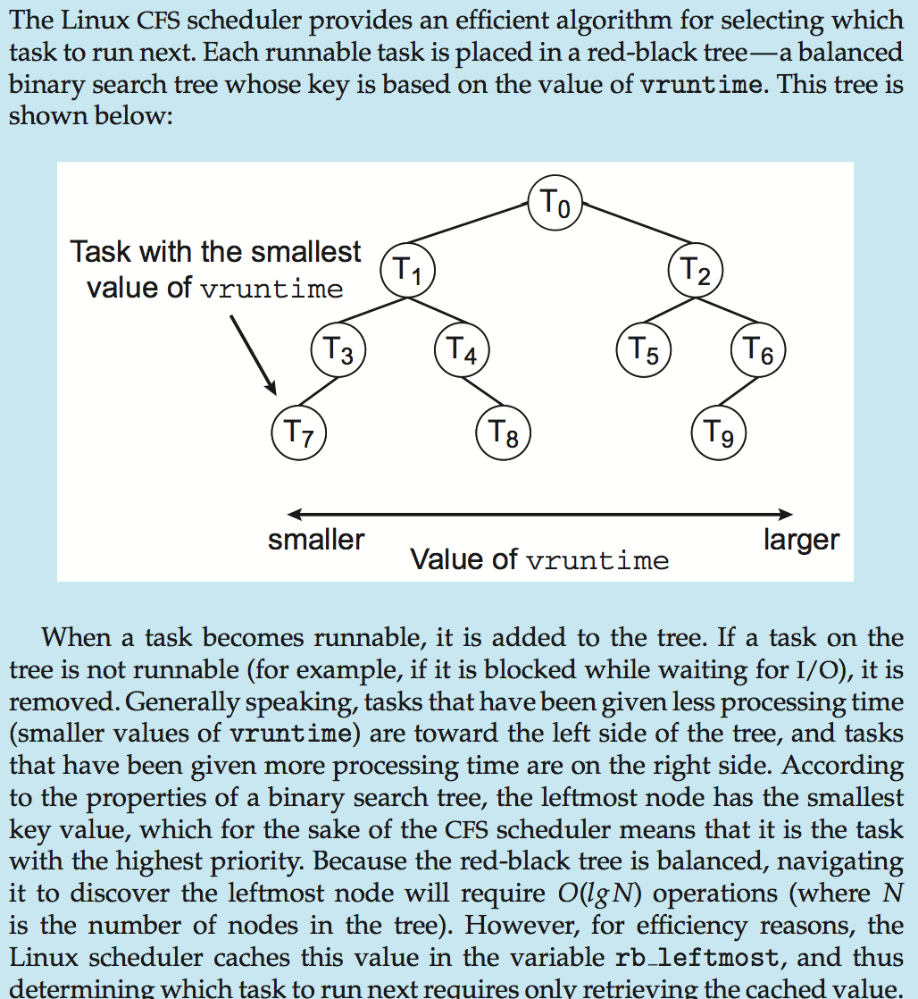
CFS Performance

Slide 40
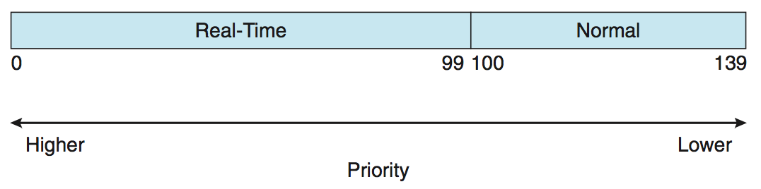
Linux Scheduling (Cont.)
Real-time scheduling according to POSIX.1b
Real-time tasks have static priorities
Real-time plus normal map into global priority scheme
Nice value of -20 maps to global priority 100
Nice value of +19 maps to priority 139

Slide 41
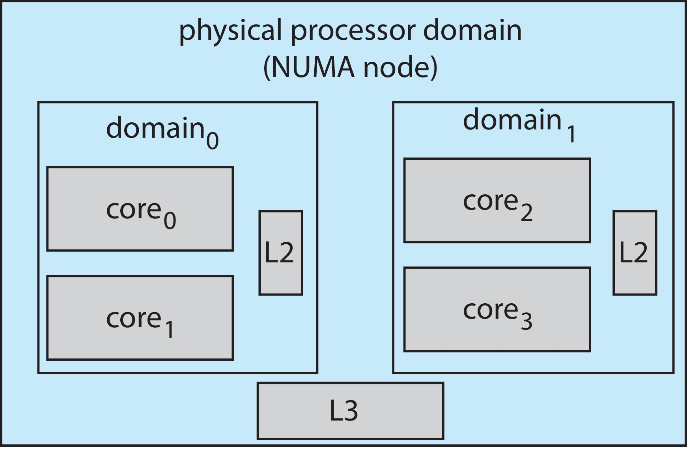
Linux Scheduling (Cont.)
Linux supports load balancing, but is also NUMA-aware.
Scheduling domain is a set of CPU cores that can be balanced against one another.
Domains are organized by what they share (i.e., cache memory.) Goal is to keep threads from migrating between domains.

Slide 42
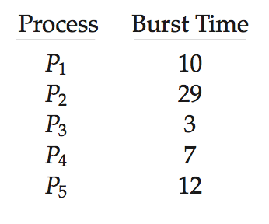
Algorithm Evaluation
How to select CPU-scheduling algorithm for an OS?
Determine criteria, then evaluate algorithms
Deterministic modeling
Type of analytic evaluation
Takes a particular predetermined workload and defines the performance of each algorithm for that workload
Consider 5 processes arriving at time 0:

Slide 43
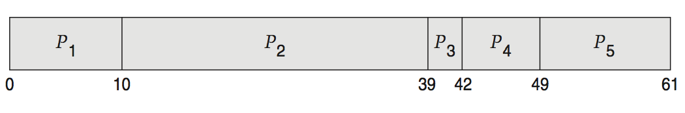
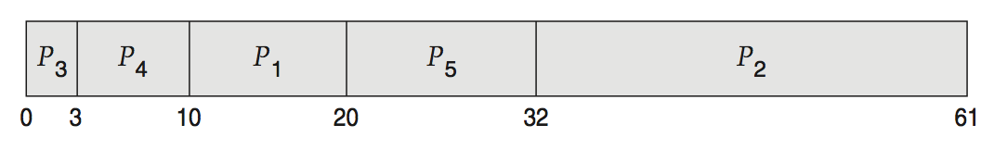
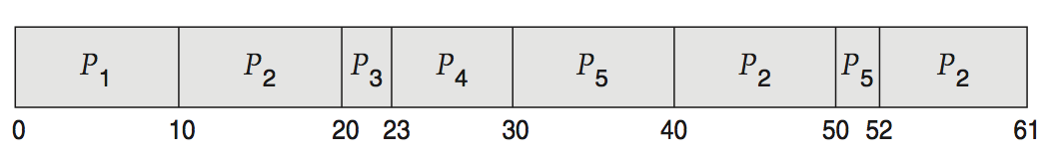
Deterministic Evaluation
For each algorithm, calculate minimum average waiting time
Simple and fast, but requires exact numbers for input, applies only to those inputs
FCS is 28ms:
Non-preemptive SFJ is 13ms:
RR is 23ms:

Slide 44
End of Chapter 5

